Slide 1

Machine Learning Assignment

Slide 2
Dataset
The data set link is https://data.cdc.gov/api/views/bxq8-mugm/rows.csv?accessType=DOWNLOAD. The data is from the United States Government website and is about deaths from various causes from 2014 to 2018.

Slide 3
Cleaning and Dimensionality Reduction
I selected the missing value ratio method for this and set a threshold of 50% of missing value.
After the application of this method, I was retained all the columns as they had 0% missing value.
The 3 most significant columns are Month, Intentional Self-Harm, and Malignant Neoplasms.

Slide 4
Cleaning
The dataset did not require cleaning as there are no missing value and the datatypes are correctly inferred.

Slide 5
Classification and Regression
I chose linear regression as it can predict a continuous set of numbers. The target variable is Intentional Self-Harm (Suicide) and the prediction was a weak one. The coefficients of all the independent variables showed only Cardiovascular disease as having a strong correlation with suicide.
I chose this because I want to predict relationship between death by suicide and other forms of death.

Slide 6
3 Other Classification and Regression
I chose, Logistics Regression, K-Means and Decision Tree
Model Evaluation
Linear Regression model gave a weak score of 0.44
Logistics Regression gave a perfect fit of 1
K-means Model evaluation was through the elbow which predicted 2 clusters and plotting the clusters shows not too well defined clusters.
Decision tree model also gave a 100% accuracy of predicting the hot or cold variable.

Slide 7
Model That Gave Maximum Performance
The models that gave maximum performance are logistics regression and decision tree. They were able to predict the outcome more accurately

Slide 8
Questions
Is death from suicide related or caused by death from malignant neoplasms?
Is the seasonal condition related to death?
3. Is death from suicide related or caused by death from Alzheimer?
4. What kind of relationship exist between suicide and Cerebrovascular Diseases
5. Is death from heart disease related to death from suicide

Slide 9
Answers
Using the regression model, the coefficient shows a very weak association and it can be concluded that there is no relationship.
The logistic regression showed a relationship between hot or cold season with death thus throwing up a possibility that more deaths occur in one season than another.
3. The simple answer is no and the coefficient of determination clearly points to less than 1.
4. This shows a fair association and worthy of investigation.
5. There is actually a weak negative relationship which is interesting. It can be implied that less people who have cerebrovascular disease die also from suicide

Slide 10
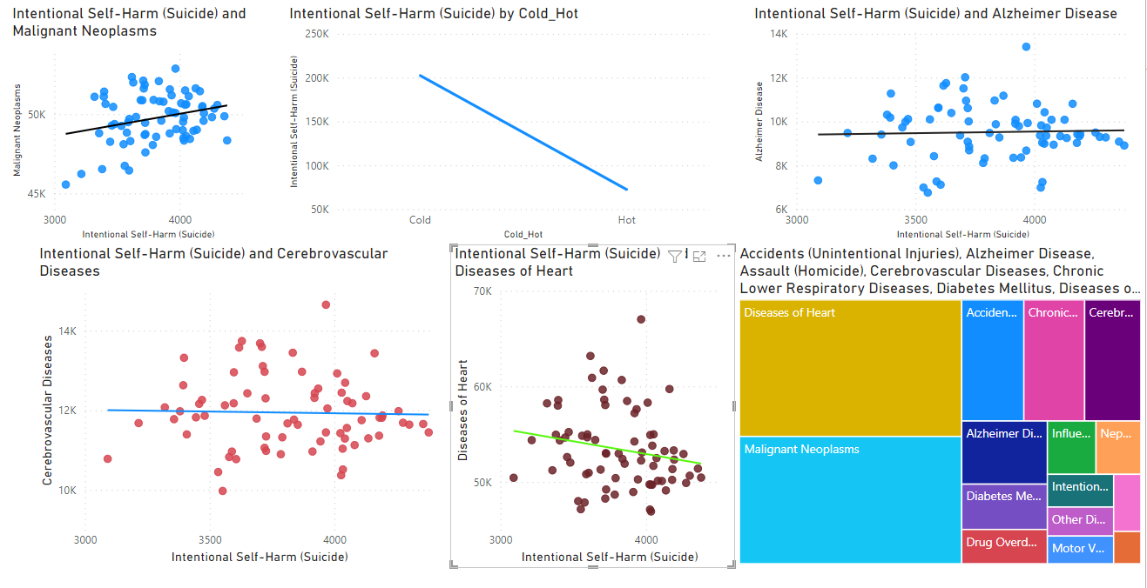
Conclusions & PowerBi Visualisations
In conclusion, the models used showed mixed results with 2 being useful and 2 showing with prediction.

